Slide 1
Concurrency
Operating System Lab-in-a-Box
Notes:
In this presentation we will take a look at “Concurrency”

Slide 2
Previous
Scheduling
Assignment
Quantitative analysis and comparisons of various schedulers
Notes:
In the previous set of slides we had a look at a number of scheduling concepts.

Slide 3
Current Module
Concurrency Scheduling
Multiprocessing environment
Read-write by multiple CPUs and consistency problem
Solutions with Mutual Exclusion, Hardware Mutex, Software Mutex
Example: Dekker’s algorithm
Use of Semaphore and preventing busy waiting
Message passing and Mail box for communication
Deadlock and Solution to avoid it.
Notes:
In this current module we will learn about concurrency scheduling, multiprocessing environment, read-write by multiple CPU, mutual exclusion by hardware and software mutex, Example: Dekker’s algorithm, use of semaphore, message passing and mail box communication, and about deadlock.

Slide 4
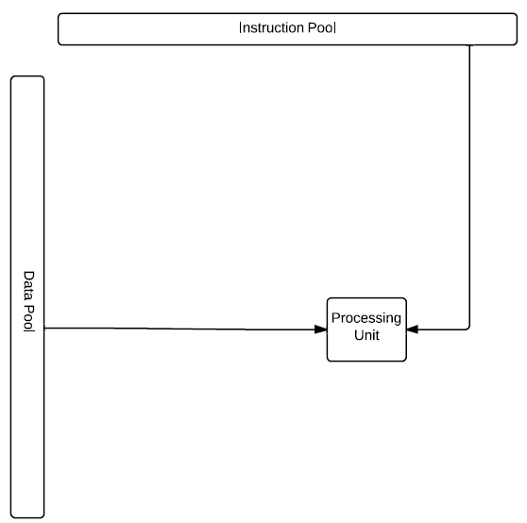
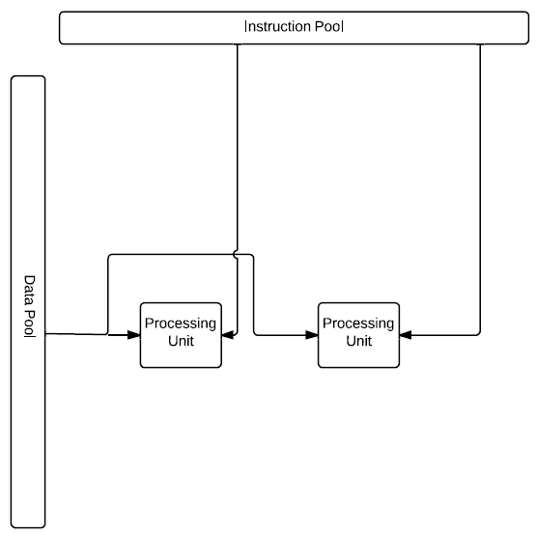
Multiprocessing and Flynn's Taxonomy
Single Instruction Single Data stream
Multiple Instruction Single Data stream
Notes:
Make the arrow from the data pool bidirectional (the processing unit often writes back result data)
In 1966, Flynn classified the computers based on the instruction stream and data stream. Descriptions of SISD and MISD are in the coming slides. The Uniprocessor machines like a PC are SISD machines. MISD machines are specially designed machines where high performance calculations are needed on every bit of data.

Slide 5
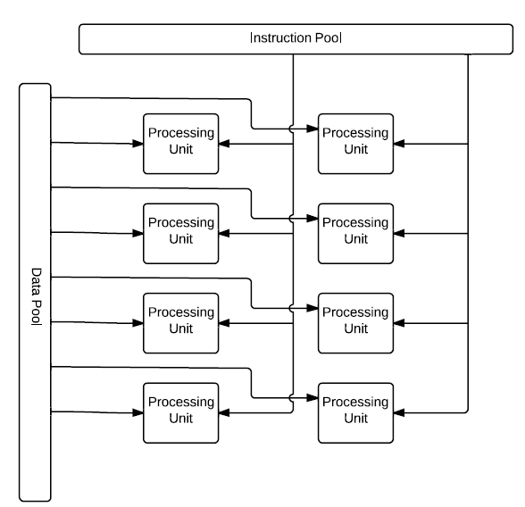
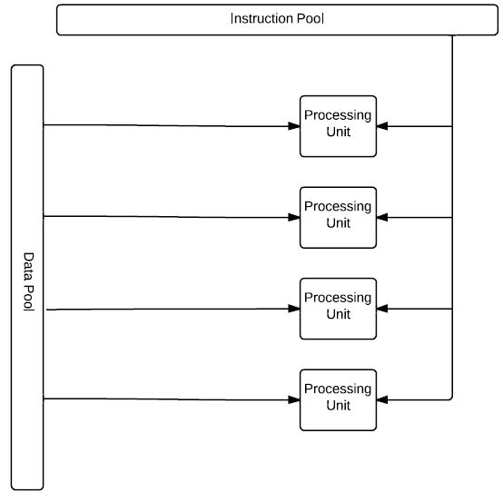
Multiprocessing and Flynn's Taxonomy
Single Instruction Multiple Data streams
Multiple Instruction Multiple Data streams
Notes:
Make the arrow from the data pool bidirectional (the processing unit often writes back result data)
SIMD and MIMD are described more in the next slide. SIMD machines are useful for image processing where every pixel in an image needs to be computed with the same instruction set.
MIMD machines are truly and fully parallel machine. Each CPU/core gets their own set of data and they compute different things on these data. The CPUs do not communicate much with each other. MIMD is useful for coarse grain parallel processing.

Slide 6
Multiprocessing and Flynn's Taxonomy
SISD
Sequential without parallelism
Concurrency at hardware level
SIMD
A single program on many processing units e.g. Graphics Processing Units (GPUs), vector processors
MISD
Rarely used
MIMD
Many processors executing different instructions on different data
Distributed systems
Shared memory
Notes:
Flynn’s classification is based on the number of instruction streams and data streams.
Single Instruction and Single Data stream (SISD) is traditional in a single CPU computer with no parallelism in either the instruction or data streams.
Single Instruction and Multiple Data stream (SIMD) does parallel operations on multiple CPUs, while all the CPUs get the same instruction and each CPU gets a different set of data. SIMD is most useful for image processing type applications. If there are multiple pixels and we need to do same operation on each pixel, this can be done by using SIMD machine.
In a Multiple Instruction and Single Data stream (MISD) machine, multiple instructions execute on a single data stream, i.e. there are multiple CPUs. All of them get the same data set, but different instructions.
In Multiple Instruction and Multiple Data stream machine (MIMD), multiple CPUs execute different instructions on different data.

Slide 7
Operating Systems on Multiprocessors
OSs on shared memory multiprocessors are different from those on uniprocessors
Centralized or symmetric: symmetric multiprocessing (SMP)
Cache organization: Shared or private L1? L2?
Memory organization
Scheduling – concurrency between processes, which processor, dynamic/static
Scheduling – concurrency between threads, one process on multiple processors, load sharing or gang scheduling?
Kernel and program: re-entrant?
Notes:
Operating systems on shared memory multiprocessors are different from operating systems on a single CPU (uniprocessor).
Shared memory architecture (SMA) and Symmetric multiprocessing refers to multiple CPUs using a shared memory module using a common bus or other channels.
Shared memory architectures are further classified as:
Uniform memory architecture (UMA): all the CPUs can access the shared memory with uniform memory access time. Example: Shared bus multiprocessor system with shared memory.
Non Uniform memory architecture (NUMA): the shared memory may be distributed, some near to the CPU, some far away from the CPU. The memory access time depends on the memory location relative to the CPU.
Cache only memory architecture (COMA): the shared memory is near to the CPU and it is a cache and the cache is shared memory.
The two key problems in an SMA system are:
"contention" when several processors try to access the same memory location and lack of "coherence" in values in private cache and shared memory.
Memory organization should be known before the scheduling can be considered. In a SMP environment, multiple processes will run on multiple CPUs. Scheduling can be handled at each CPU independently by independent OS or one OS can schedule all the processes on multiple CPUs.

Slide 8
Concurrency
Uniprocessor – interleaved processes
More problems as a result of multiple processes running simultaneously (overlapping)
More sophisticated – same abstraction as uniprocessor?
Can simple abstraction encapsulate all the features?
How do programmers modify their programs to accommodate the proper abstraction?
Resource management – share resources in a safe and optimized way
Can a resource always be shared? – mutex and deadlock
Potential dependency
How to share?
Room for improvement and optimization?
Evaluation and debugging – unpredictable behaviour
Are all these tasks for the OS only? Can hardware, application software and users help?
Notes:
Multiple processes can run concurrently on a uniprocessor with interleaved or time shared execution, or simultaneously on multiple processor systems. Resource management, for example, utilization of shared memory by multiple processes correctly without overwriting the values and writing in the correct sequence is tough, but doable with proper control.

Slide 9
The Read-Write Problem Caused by Sharing
Global variable shared = 0 at the beginning
Two processes in parallel:
temp1=shared+1;
shared =temp1;
temp2=shared+2;
shared=temp2;
What is the value of shared at the end?
1?
2?
3? (Sequential)
What do you expect from running this sort of program?
Notes:
This slide shows the problem caused by sharing a global variable. The variable 1 is incremented by both processes and the result can be 1,2 or 3 depending on the execution sequence.

Slide 10
Mutual Exclusion
Mutually exclusive resources such as shared variables, or printers (a hardware device)
Race condition – non-deterministic, depends on the execution sequence of processes
Mutex controls access to shared resources, you get the expected value as if processed by a uniprocessor system
Enforced to ensure only one thread of execution can have access at any time
Critical Section – the code that accesses the mutually exclusive resource
Requirements for good mutex:
Enforced
Mutual
The only reason a request to a critical section is rejected/delayed is that another process is accessing already
Process can only access the critical section for a finite time
No deadlock and starvation
Notes:
Mutually exclusive resources such as shared variables and devices like printers, can be accessed by one process at a time with the help of concurrency control/mutual exclusion control (Mutex) techniques. A race condition is one where multiple processes are allowed access to a resource (or variable) and the results are unpredictable. By using mutex control, one can prevent race condition.
A critical section is the section of code or shared resource that needs to be run/used. A mutex enforces mutually exclusive access to the shared resource to only one process at a time. It also helps to avoid dead lock and starvation. Starvation is a state when one task gets access to the shared resource very rarely or not at all. Dead lock happens if there are multiple shared resources while each process or task has access to one of the resource and need access to another resource that is held by another task during deadlock, no task is executed and no progress is made. There are solutions to solve deadlock situations.

Slide 11
Solutions
Competition for the resource(s)
The operating system (or other form of intermediary) has to deal with the problem
A mutex can be implemented on both, the hardware level and the software level
Hardware – when something is in the critical section, disable all possible interrupts
Software – busy-waiting is the common problem, also deadlock and starvation
Also OS services:
Semaphores
Message Passing
Notes:
The solution for mutually exclusive access is provided by the operating system and it uses various methods for control, including “Semaphores”. The mutex can be implemented using hardware or software methods. Hardware solutions involve disabling further interrupts by other tasks when one task is using a shared resource. Software solutions with semaphores may create a problem called busy-waiting and also problems like deadlock and starvation, but there are solutions to overcome these problems. Operating system services include semaphores and message passing between processes.

Slide 12
Hardware Mutex
For a uniprocessor system, it is sufficient to just disable interrupts! Common technique used in embedded software
What about multiprocessors?
Atomic instructions – indivisible operations
Read/write to memory is always atomic
Based on testing the states of memory: test-and-set, compare-and-swap
Busy waiting
Cannot prevent deadlock and starvation
2 Locks and 2 processes
More than 3 processes
Hardware alone is clearly not enough
Helpful and provides support for software approach
while(true){
while(compare_and_swap(lock,0,1)==1){
/* critical section*/;
lock=0;
}
}
Notes:
In a uniprocessor environment, a hardware mutex involves disabling interrupts. But in a multiprocessor environment, it is not enough. In a multiprocessor environment, read-write on shared memory is atomic (only one task can do it at a time and it can not be interrupted). Atomic operations can be done using “test-and-set” and “compare and swap”.

Slide 13
Software Mutex
How to detect the state of the resource? - flags
Examine the flags before entering a critical section, if not met then wait
Clear the flag before leaving
The problem becomes what sort of flags to set and how to manage the flag
Try yourself
Without causing deadlock or starvation
Needs hardware atomic instructions support
Out-of-order execution
Memory barrier instructions
Some well-known algorithms:
Dekker’s algorithm – 1965 – First known correct solution to the mutex problem
Lamport's bakery algorithm – 1974
Notes:
Students will be asked to implement some of the algorithms in the lab session. You will do a lab exercise on the use of software mutexes, atomic instruction, Dekker’s algorithm and Lamport’s bakery algorithm.
Binary semaphores can be released by any task, even a task that did not originally acquire the semaphore. But mutexes have the task ownership property which allows only the task acquired to release it.
Software mutexes and flag bits in control registers can be used to detect the state of the resource. If the flag is set, the critical section is in use. Do busy waiting - repeatedly check the value of the flag bit.
The process using the shared resource will clear the flag while releasing the resource.
Some of the well known algorithms like Dekker’s algorithm and Lamport’s bakery algorithm provide solutions to the above problems.

Slide 14
Dekker’s algorithm
begin integer c1, c2 turn; c1:= 1; c2:= 1; turn = 1; parbegin process 1: begin A1: c1:= 0; L1: if c2 = 0 then begin if turn = 1 then goto L1; c1:= 1; B1: if turn = 2 then goto B1; goto A1 end; critical section 1; turn:= 2; c1:= 1; remainder of cycle 1; goto A1 end;
process 2: begin A2: c2:= 0; L2: if c1 = 0 then begin if turn = 2 then goto L2; c2:= 1; B2: if turn = 1 then goto B2; goto A2 end; critical section 2; turn:= 1; c2:= 1; remainder of cycle 2; goto A2 end parend end .
Dijkstra, E. W. "Cooperating Sequential Processes, manuscript, 1965.“ – The original paper that introduces the Dekker’s algorithm
Notes:
Students will be asked to implement this in the lab session.
A more “readable” C version can be found in the solution project.
Dekker's algorithm is the first known correct solution to the mutual exclusion problem. Access to the critical section is given via the use of two flags, wants_to_enter[0] and wants_to_enter[1], which indicate an intention to enter the critical section on the part of processes 0 and 1, and a parameter “turn” states which process has priority to use the critical section.

Slide 15
Semaphore
In the same paper, Dijkstra provided another approach that allows concurrency control over multiple identical exclusive resources – semaphore
An integer variable s (or a structure) records the number of currently available resources
The initial value of s – number of copies of the resource
Two operations can modify the variable
wait(s) – originally P (proberen) by Dijkstra: request of resource, decrement s and only grant access if s is positive, otherwise blocked
signal(s) – originally V (verhogen) by Dijkstra: release of resource, increment s and dispatch the next blocked process
Notes:
A semaphore is a variable to give access to a critical section.
Dijkstra in his paper explained the use of a semaphore for controlling access to a critical shared resource. Two operations that can modify the variable are: Wait and Signal.

Slide 16
An Example
Three public bikes are provided to students
You need to ask for a key at the front desk
After use, return the key and bike
Can the front desk use a semaphore to manage the bikes?
int key =3;
……
void student(){
wait(key);
/*critical section*/
signal(key);
}
Correct?
Are the keys/bikes identical?
Yes, then correct
What if they’re not? Use mutex instead
Notes:
Further discussion by Michael Barr at http://www.barrgroup.com/Embedded-Systems/How-To/RTOS-Mutex-Semaphore
Here's how to use a mutex:
/* Task 1 */
mutexWait(mutex_mens_room); // Safely use shared resource
mutexRelease(mutex_mens_room);
/* Task 2 */
mutexWait(mutex_mens_room); // Safely use shared resource
mutexRelease(mutex_mens_room);
By contrast, you should always use a semaphore like this:
/* Task 1 - Producer */
semPost(sem_power_btn); // Send the signal
/* Task 2 - Consumer */
semPend(sem_power_btn); // Wait for signal

Slide 17
Semaphore
Semaphore does not keep track of the order of access – effectively treating all resources identically
How do we schedule the blocked processes?
Strong semaphore: FCFS queue - Dijkstra
Weak semaphore: randomly decide the next waiting process – starvation!
Binary semaphore: s ∈ {0,1} or boolean type
Possible to make a general semaphore by using a private integer variable and two binary semaphores
The solution is also given in the original paper by Dijkstra
Notes:
Semaphores do not keep track of the order of access – effectively treating all resources identically. A blocked process can be scheduled from the FCFS queue or randomly the next waiting process. The two most common kinds of semaphores are counting semaphores and binary semaphores. Counting semaphores can be used for multiple resources and multiple processes. A binary semaphore, represents 0 or 1; locked or unlocked. Semaphores were invented by the late Edsger Dijkstra.

Slide 18
How Do Semaphores Prevent Busy-Waiting
The busy-waiting semaphore is sometimes referred to as a spinlock
Sometimes useful in SMP
Avoids context switching if just waiting for short time
Or block the process if there is no available resource!
Wait() – if s = 0 – Event Wait
Signal() – Event Occurs
Need a queue or a list
Notes:
The busy-waiting semaphore is sometimes referred to as a spinlock. They are useful in SMP. This avoids context switching if just waiting for short time.
A semaphore can only be accessed using the following operations: wait() and signal().
wait() is called when a process wants access to a resource.
signal() is called when a process is done using a resource.
Processes check the value of the semaphore repeatedly, this is busy waiting and wastes CPU time. The semaphore causing busy waiting is called a spinlock. To prevent it, create a queue of processes waiting to use the semaphore/resource. A block() system call suspends the process and the wakeup(P <Process>) system call resumes the execution of blocked process P. On wait() call from a process on a semaphore, the process is added to the semaphore’s queue and then blocked. The process’s state is switched to the waiting state, and the CPU scheduler then allows another process to execute. When another process increments the semaphore by calling signal() and one task from the queue is executed.

Slide 19
Producer-Consumer Problem
A common application for semaphores is discussed in the original paper by Dijkstra.
Single buffer
The implementation of the buffer does not matter
Two cyclic processes (could be more than two):
Producer produces a portion of information and adds (writes) that to the buffer
Consumer takes (reads) a portion of information from the buffer and consumes it
Two problems:
Exclusive access to the buffer
Buffer underflow or overflow (bounded buffer, also discussed in the paper)
Notes:
The producer–consumer problem (or bounded-buffer problem) is an example of multi-processes sharing a common, fixed-size buffer being used as a queue.
The producer inserts data into the buffer. The consumer consumes the data. The producer should not add data into the buffer if it's full and the consumer should not try to remove data from an empty buffer.
The solution can be reached using semaphores. Instead of one producer and one consumer, multiple producers and multiple consumers that share a single shared buffer can be analysed.

Slide 20
Producer-Consumer Problem
begin integer number of queuing portions, buffer manipulation; number of queuing portions:= 0; buffer manipulation:= 1; parbegin producer: begin again 1: produce next portion; P(buffer manipulation) ; add portion to buffer; V(buffer manipulation); V(number of queuing portions); goto again 1 end; consumer: begin again 2: P(number of queuing portions); P(buffer manipulation); take portion from buffer; V(buffer manipulation); process portion taken; goto again 2 end parend end
Dijkstra, E. W. "Cooperating Sequential Processes, manuscript, 1965.“ – The original paper that introduces the Dekker’s algorithm
Notes:
Reference: https://en.wikipedia.org/wiki/Producer%E2%80%93consumer_problem
A simple example solution for the producer and consumer problem with a semaphore is given.

Slide 21
Message-Passing/Mailbox
Alternatively, the operating system provides the following primitives:
send (destination, message) – usually nonblocking
receive (source, message) – usually blocking
As an aid to exchange information, they may be used in synchronisation and building mutex
In addition to the shared memory case, also works on distributed systems
Mutex:
A token message, a process either has it or is waiting for it
Who ever owns the token can access a critical section
Return the token to the mailbox after use
Producer-consumer problem:
TCP
while (1) {
receive (mailbox, token);
/* critical section */;
send (mailbox, token);
}
Notes:
Inter-Process Message Passing is useful for data transfer. It can also be used just for synchronization and it can co-exist with shared memory communication.
There are two basic operations for message passing: send(message) and receive(message).
The passed message from each process can be data, remote procedure calls, executable code etc. The message usually contains standard fields, destination process ID, sending process ID for any reply, message length, data type, data etc. A token message can be used for controlling access to a critical section.

Slide 22
More problems…
Readers-writers problem
Priority?
Dining philosophers problem
Cigarette smokers problem
Notes:
There are more challenging problems such as the Readers-Writers problem and also the Dining philosophers problem.
For the dining philosophers problem, there are five philosophers sitting around a table with bowls of spaghetti. Forks are placed between each pair of adjacent philosophers. A philosopher can only eat spaghetti when he has both a left and a right fork. After he finishes eating, he needs to put down both forks so they become available to others.
The problem is how to design a method such that no philosopher will starve.

Slide 23
Deadlock
Imagine all the philosophers pick their left-hand side fork at the same time. What would happen?
Everyone waits for their right-hand side philosopher to release their fork
While keeping their own fork
Cold war on the dining table – deadlock
All processes are waiting for others to finish so that required resources will be released, while reluctant to give up the resources that are also required by others. Thus nobody ever finishes.
Generally, no perfect solutions yet.
Notes:
If each philosopher picks a fork on the left, and waits for the fork on the right, it will lead to dead lock.
We can add a rule that the philosophers put down a fork after waiting ten minutes for the other fork to become available and wait a further ten minutes before making their next attempt. This scheme eliminates deadlock (but still suffers from the problem of livelock (All philosophers are waiting at the same time in a synchronized way).
Dijkstra’s solution: The resources (forks) will be numbered 1 through 5 and each unit of work (philosopher) will always pick up the lower-numbered fork first, and then the higher-numbered fork, from among the two forks he plans to use. There are other solutions too.

Slide 24
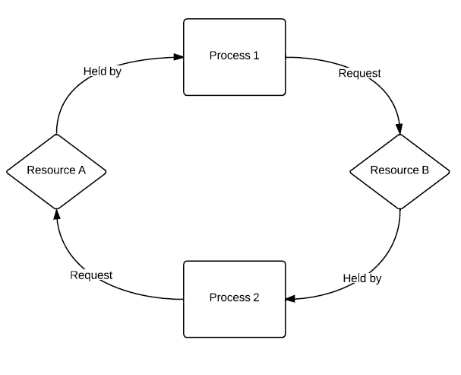
Coffman Conditions for Deadlock
If the following conditions are all true, deadlock may occur:
Mutex: exclusive resource, non-shareable
Resource holding: request additional resources while holding one
No preemption: resource can not be de-allocated or forcibly removed
Circular wait: circular dependency or a closed chain of dependency
necessary but not
sufficient conditions
Notes:
A deadlock (infinite wait) occurs when a process enters a wait state because a shared resource that was requested is being held by another waiting process, which in turn is waiting for another resource held by another waiting process.
Deadlock prevention works by preventing one of the four Coffman conditions from occurring:
Removing the mutual exclusion condition means that no process will have exclusive access to a resource (called non-blocking synchronization algorithms).
The hold and wait or resource holding conditions are changed by making processes ask for all the resources they will need before starting up, this is difficult.
Allowing the pre-emption condition will cause difficulty and the processing outcome may be inconsistent or thrashing may occur.
The final condition is the circular wait condition. Approaches that avoid circular waits include disabling interrupts during critical sections.

Slide 25
Dealing with Deadlock
Ostrich algorithm
Deadlock prevention: if any of the Coffman conditions are false
Mutex is inevitable
Request all resources at the beginning– either pick two forks at the same time or wait / all-or-none
Preemption is inevitable
Prevent circular wait condition: Resource hierarchy solution again by Dijkstra
The only practically avoidable condition
Deadlock avoidance
Evaluate the chance of deadlock while allocating a resource. Grant or deny based on this information
Banker’s algorithm
Deadlock detection: what to do with the existing deadlock?
Model checking
Kill all or part of the deadlocked processes?
Resource preemption?
Restart? Watchdog for embedded system
Notes:
Ostrich’s effect is defined as "to stick one's head in the sand and pretend there is no problem."
If a deadlock problem in an application occurs rarely, then it is ignored by using the Ostrich algorithm.
Deadlock can be avoided by: evaluating the chance for deadlock over a resource. Grant or deny access to the resource based on this information or similar to Banker’s algorithms. The bank does not run out of resources, because the bank would never allocate its money in such a way that it can no longer satisfy the needs of all its customers. In rare cases, when the bank has no money (deadlock), the customer must wait until some other customer deposits enough.
Dead lock recovery includes:
Kill all deadlocked processes (restart)
Kill one deadlocked process at a time and release its resources
Steal one resource at a time (Resource Preemption), Roll back all or one of the processes to a checkpoint that occurred before they requested any resources, then continue.

Slide 26
Banker’s Algorithm
Assume the following is known
1.Max possible resources requested
2.Resources allocated
3.Resources still available
Find the process with the fewest currently needed resources, which is also fewer than currently available resources
Grant Process 2’s request, then Process 3’s and finally Process 1’s
Possible to have no solutions! (safe/unsafe)
Practical?
 | Max |  |  | Allocated |  |  | Need |  |  | Avaliable
 | A | B | C | A | B | C | A | B | C | A | B | C
Process1 | 3 | 3 | 1 | 1 | 1 | 1 | 2 | 2 | 0 | 1 | 2 | 1
Process2 | 0 | 1 | 2 | 0 | 0 | 1 | 0 | 1 | 1
Process3 | 1 | 2 | 2 | 0 | 1 | 0 | 1 | 1 | 2
Notes:
The Banker’s algorithm was briefly explained in the last slide.
For the example problem in the slide find the process with the fewest currently needed resources and grant it. Follow this process. Check whether this gives a full solution.

Slide 27
Next
Lab
Memory
Notes:
In the next set of slides we will discuss “Memory”.

